Slide 1



Summary / Planning / Presentation
Search IT job in China
：Long Jin
：Wenda Li
：Pathathai Na Lumpoon

Slide 2

CONTENTS
1
Overview Project
2
Progress 1
3
Nest Stage-Progress 2

Slide 3
PART 01
Overview Project
1. Definition and motivation
2. Type of user
3. Technology
4. Total Feature
5. System architecture
6. Limitation

Slide 4

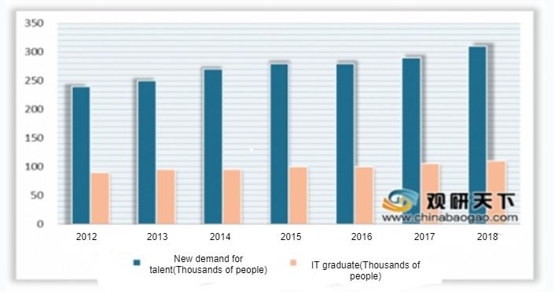
Definition and motivation
What is this
Website
Motivation

Slide 5




Type of user
Search Job website
Job seeker
Register, login, save job position, search job, visual map, manage personal information.
Company
Admin
Register, login, manage job information
Login, manage user information,

Slide 6
Technology
01
FRONTEND
01
Node.js
DATABASE
Vue.js
Connect frontend and database
PhpMyAdmin
标题文字添加

Slide 7
Total Feature
#1 Register
#2 Login
#3 Manage job information
#4 Save job position
Feature
#5 Search jobs by keywords
#6 Visual map
#7 Manage personal information
#8 Manage user information

Slide 8
Complete the steps
Proposal
Progress 1
Progress 2
Show Progress
Final Progress
Feature #1,#2, #8
Feature #3, #4, #5
Feature #6
Feature #7

Slide 9
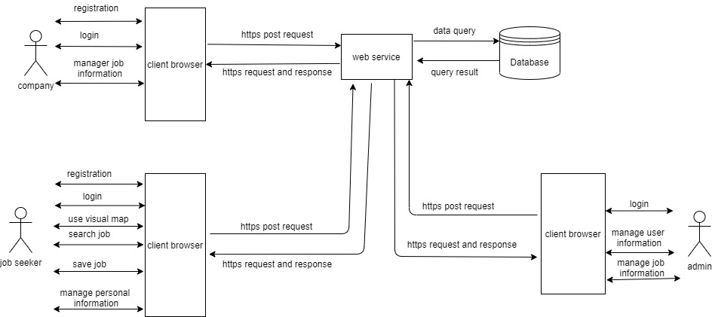
System architecture

Slide 10
Limitation
Sometimes may use VPN
Only English language
Internet connection is required
Only IT industry
authenticity of the job information cannot be determined.

Slide 11
PART 02
Progress 1
1. Finish Feature
2. Software Requirement Specification
3. Software design
4. Test
5. Demo
6. the problem we are facing

Slide 12

Finish Feature
Login
1. Job seeker
2. Company
Register
3. Admin
Job seeker
Manage user information
2. Company
Admin can manage job seeker and company account information

Slide 13
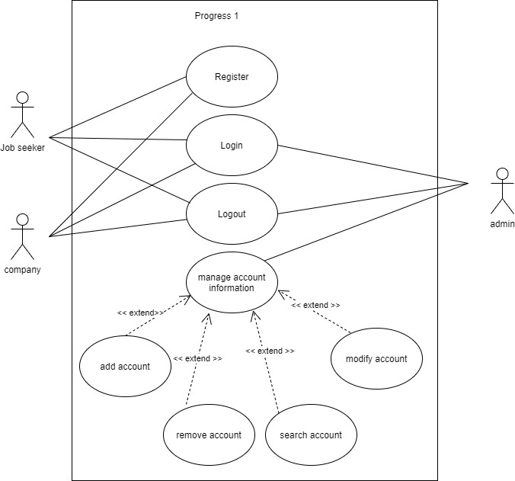
Software Requirement Specification
Use Case diagram

Slide 14
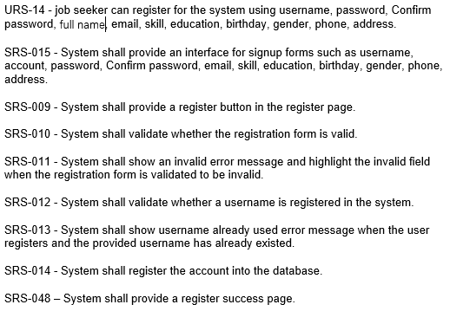
Software Requirement Specification
Example: Job seeker register

Slide 15
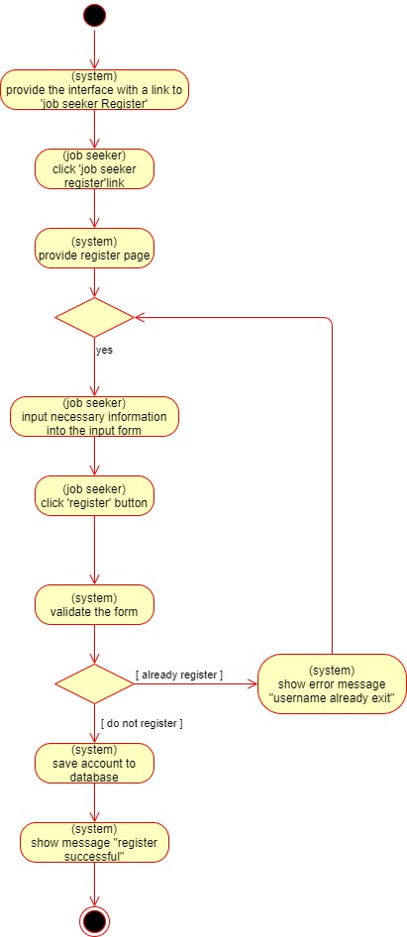
Software Requirement Specification
Example: job seeker register
Activity diagram
(AD-03)

Slide 16
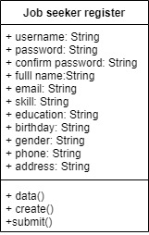
Software design
Example: job seeker register
class diagram
(CD-10)

Slide 17
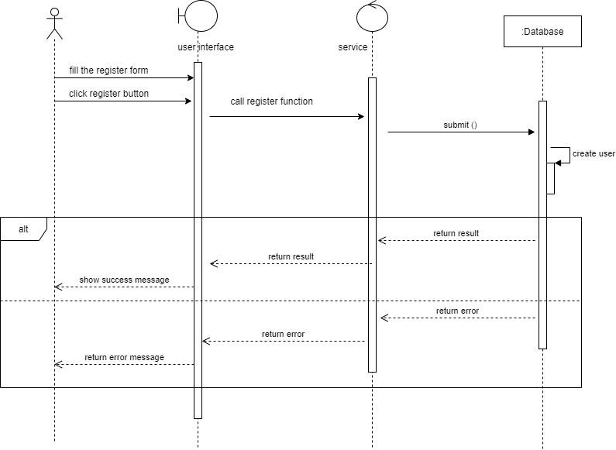
Software design
Example: job seeker register
Sequence diagram
(SD-01)

Slide 18
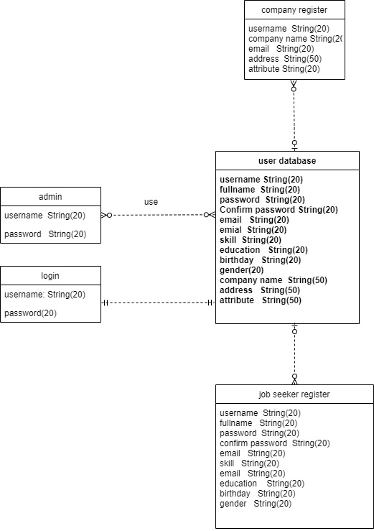
Software design
ER- diagram

Slide 19
Test
Test
Unit test
System test

Slide 20
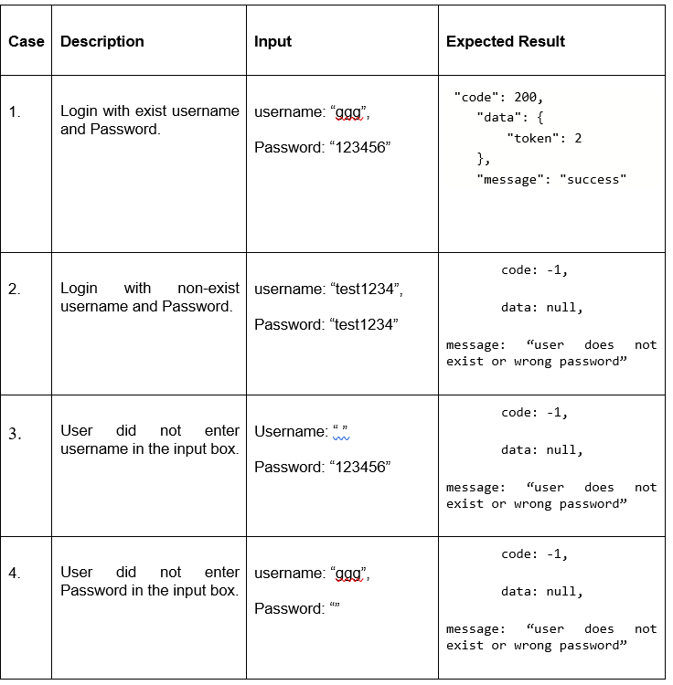
Test-example
Unit Test Case(UTC-03)

Slide 21
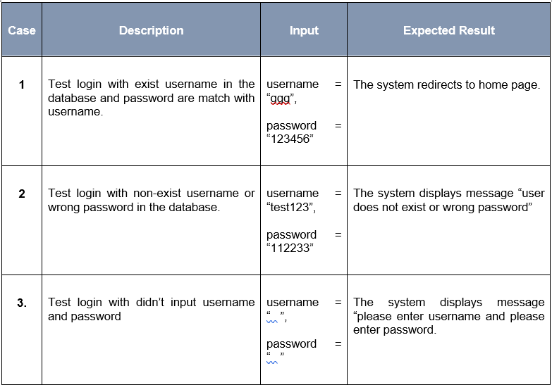
Test-example
System Test Case (STC-03)
System test

Slide 22
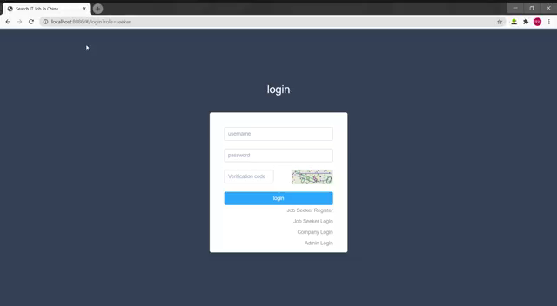
Demo
视频
Demo

Slide 23
Finish
100%
100%
0%
0%
0%
Proposal
Progress 1
Progress 2
Show Progress
Final Progress

Slide 24

Difficulties
Register
Test
Doc
The parameter have Null in the database.
Aj suggest use Postman

Slide 25
PART 03
Next Stage-Progress 2

Slide 26

Next Stage
标题文本预设
#3 Manage job information
标题文本预设
#4 Save job position
标题文本预设
#5 Search jobs by keywords
标题文本预设

Slide 27
Summary / Planning / Presentation
THANK YOU
Question

